Slide 1

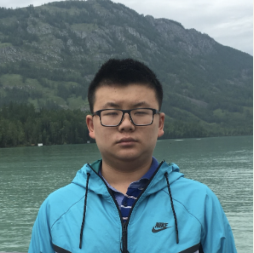



Adversarial Robustness on Insertion-Deletion Streams
Elena Gribelyuk
Princeton
Honghao Lin
CMU
David P. Woodruff
CMU
Huacheng Yu
Princeton
Samson Zhou
Texas A&M

Slide 2



Streaming Model
Massive Data Streams
Internet traffics
Sensor networks
Stock Markets

Slide 3

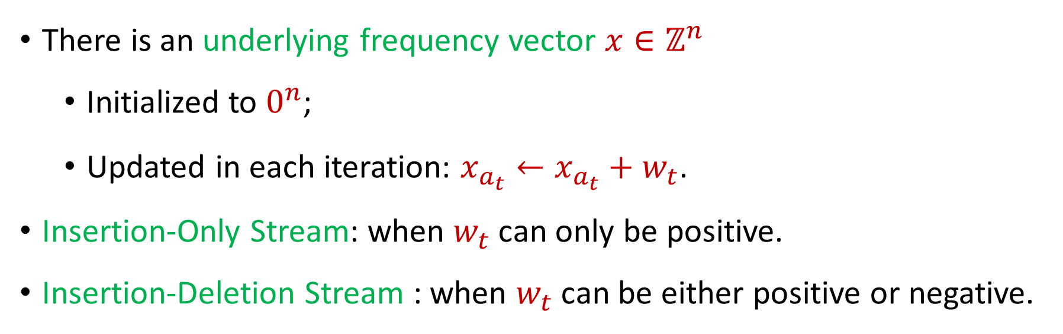
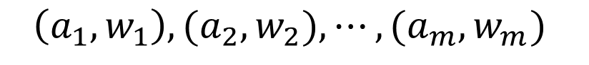
Streaming Model
$$\left(a_{1}, w_{1}\right), {(a}_{2}, w_{2}), ⋯, {(a}_{m}, w_{m})$$
There is an underlying frequency vector $x∈ℤ^{n}$
Initialized to $0^{n}$;
Updated in each iteration: $x_{a_{t}}←x_{a_{t}}+w_{t}$.
Insertion-Only Stream: when $w_{t}$can only be positive.
Insertion-Deletion Stream : when $w_{t}$ can be either positive or negative.

Slide 4
Lots of problems…
Graph problems: Matchings, MST, MAX-CUT
Geometric problems: Clustering, facility location
Statistical problems: Heavy-hitters, norm/moment estimation, quantile estimation
Algebraic problems: Subspace embeddings, regression, low-rank approximation
String problems: pattern matching, periodicity
Others: CSPs, coding theory, submodular optimization, etc

Slide 5

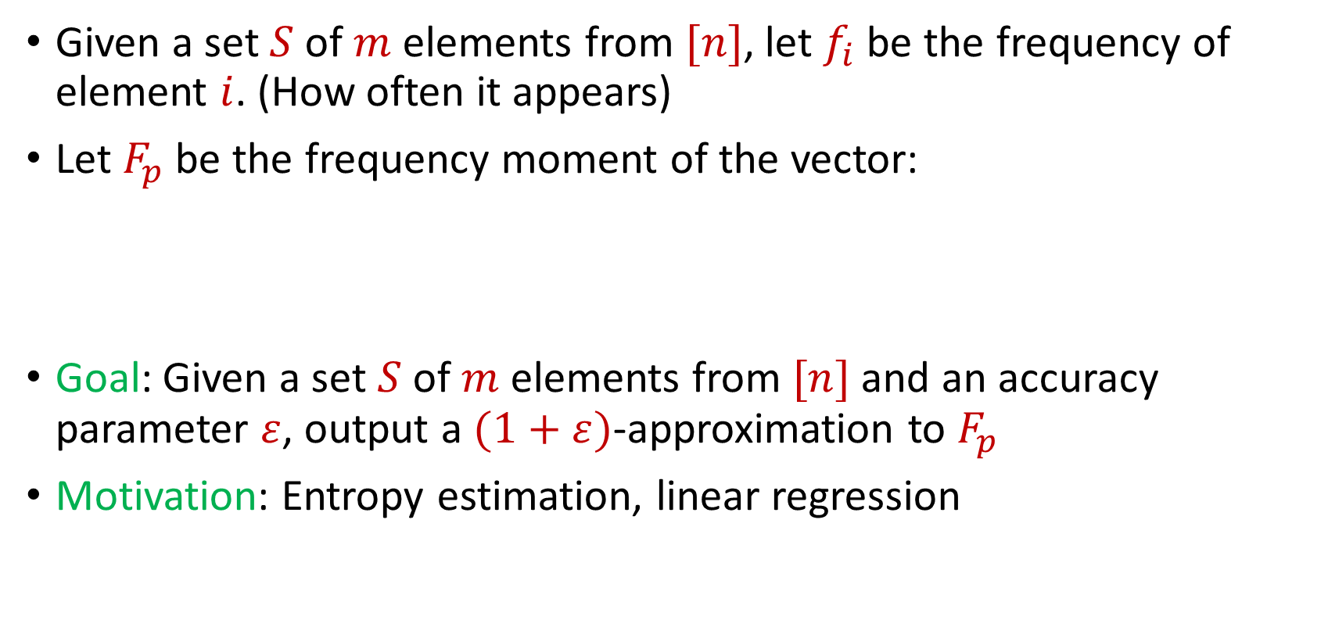
Frequency Moments
Given a set $S$ of $m$ elements from $[n]$, let $f_{i}$ be the frequency of element $i$. (How often it appears)
Let $F_{p}$ be the frequency moment of the vector:
Goal: Given a set $S$ of $m$ elements from $[n]$ and an accuracy parameter $ε$, output a $(1+ε)$-approximation to $F_{p}$
Motivation: Entropy estimation, linear regression
$$F_{p}={\left|f_{1}\right|}^{p}+{\left|f_{2}\right|}^{p}+ …+{\left|f_{n}\right|}^{p}$$

Slide 6
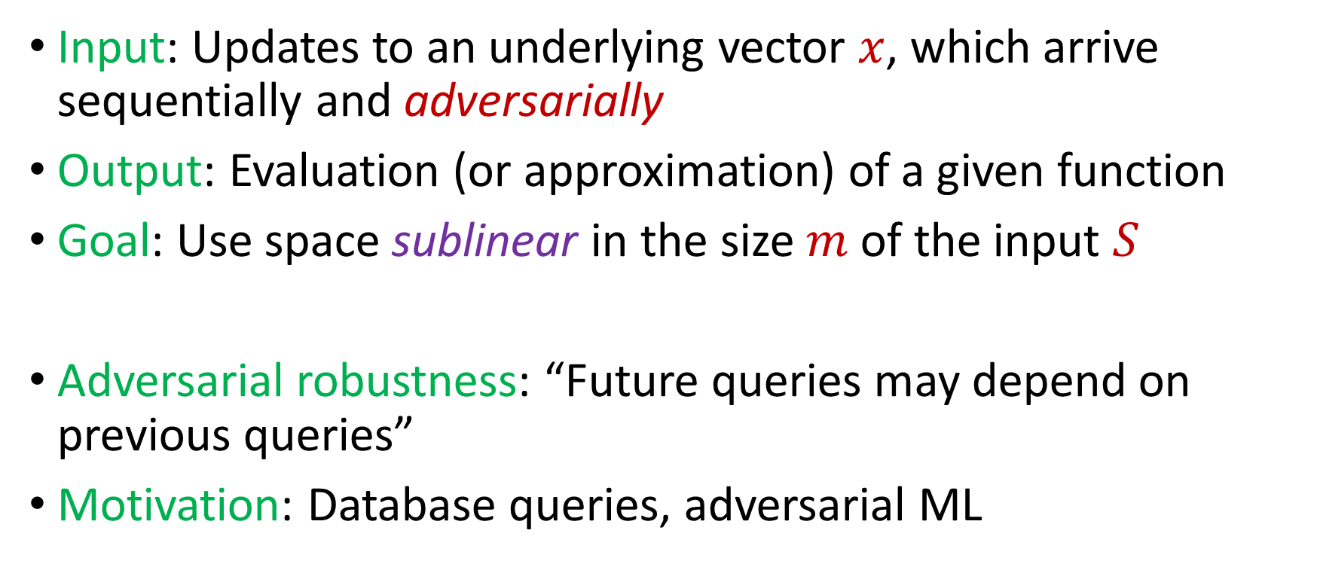
Adversarially Robust Streaming
Input: Updates to an underlying vector $x$, which arrive sequentially and adversarially
Output: Evaluation (or approximation) of a given function
Goal: Use space sublinear in the size $m$ of the input $S$
Adversarial robustness: “Future queries may depend on previous queries”
Motivation: Database queries, adversarial ML
Notes:
Let’s start by breaking down each of the terms in the title. To understand the sliding window model, we first have to understand the streaming model of computation, in which elements of an underlying data set S, arrive sequentially and the goal is to evaluate or approximate some given function on this dataset, using space sublinear in S. In the sliding window model, only the W most recent updates form the underlying data set

Slide 7


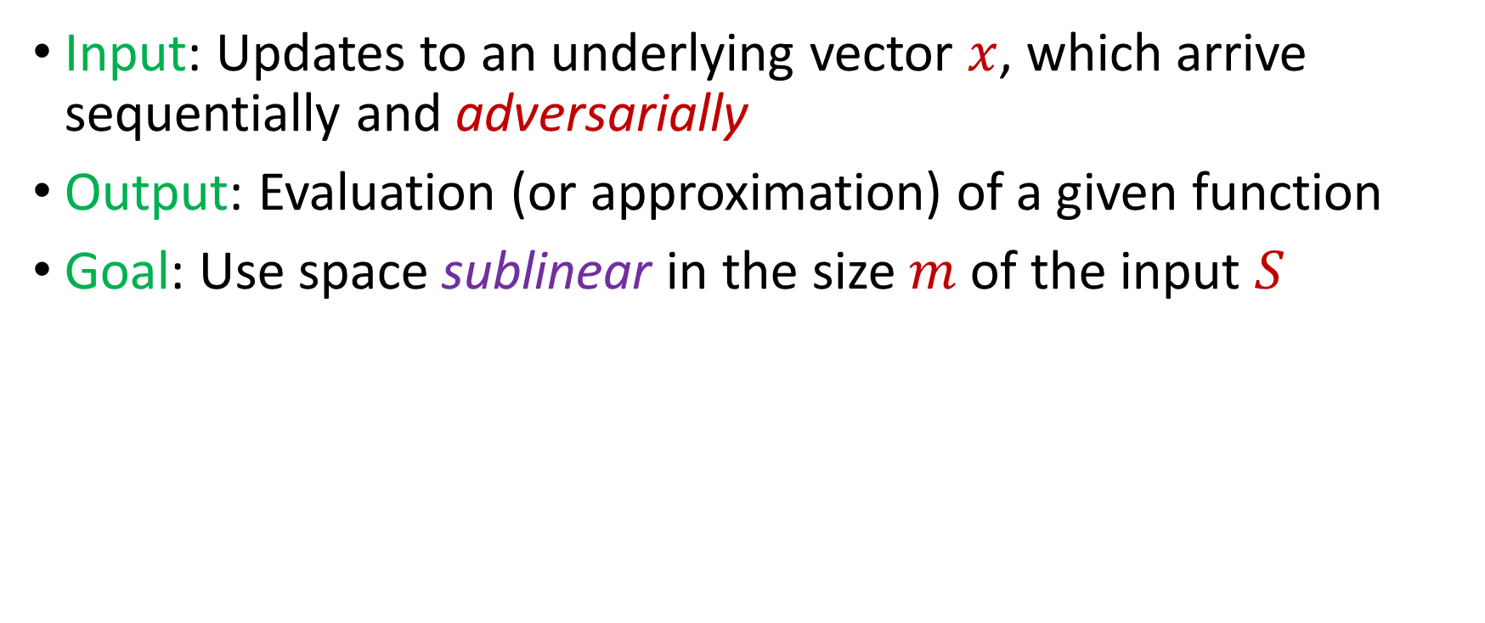
Adversarially Robust Streaming
Input: Updates to an underlying vector $x$, which arrive sequentially and adversarially
Output: Evaluation (or approximation) of a given function
Goal: Use space sublinear in the size $m$ of the input $S$
Attacker
Algorithm
Notes:
Alg是l0 alg

Slide 8
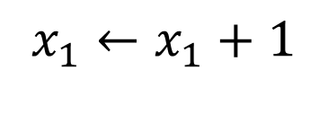
Adversarially Robust Streaming
Input: Updates to an underlying vector $x$, which arrive sequentially and adversarially
Output: Evaluation (or approximation) of a given function
Goal: Use space sublinear in the size $m$ of the input $S$
$$x_{1}←x_{1}+1$$
1
Attacker
Algorithm

Slide 9
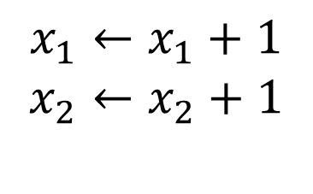
Adversarially Robust Streaming
Input: Updates to an underlying vector $x$, which arrive sequentially and adversarially
Output: Evaluation (or approximation) of a given function
Goal: Use space sublinear in the size $m$of the input $S$
$$x_{1}←x_{1}+1$$
$$x_{2}←x_{2}+1$$
2
Attacker
Algorithm

Slide 10
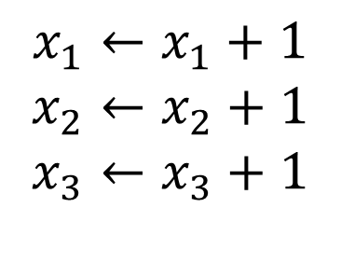
Adversarially Robust Streaming
Input: Updates to an underlying vector $x$, which arrive sequentially and adversarially
Output: Evaluation (or approximation) of a given function
Goal: Use space sublinear in the size $m$of the input $S$
$$x_{1}←x_{1}+1$$
$$x_{2}←x_{2}+1$$
$$x_{3}←x_{3}+1$$
3
Attacker
Algorithm

Slide 11
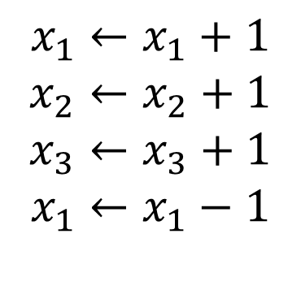
Adversarially Robust Streaming
Input: Updates to an underlying vector $x$, which arrive sequentially and adversarially
Output: Evaluation (or approximation) of a given function
Goal: Use space sublinear in the size $m$of the input $S$
$$x_{1}←x_{1}+1$$
$$x_{2}←x_{2}+1$$
$$x_{3}←x_{3}+1$$
$$x_{1}←x_{1}−1$$
4
Attacker
Algorithm

Slide 12

Adversarially Robust Streaming
Input: Updates to an underlying vector $x$, which arrive sequentially and adversarially
Output: Evaluation (or approximation) of a given function
Goal: Use space sublinear in the size $m$of the input $S$
$$x_{1}←x_{1}+1$$
$$x_{2}←x_{2}+1$$
$$x_{3}←x_{3}+1$$
$$x_{1}←x_{1}−1$$
4
Attacker
Algorithm
Notes:
adversarially

Slide 13
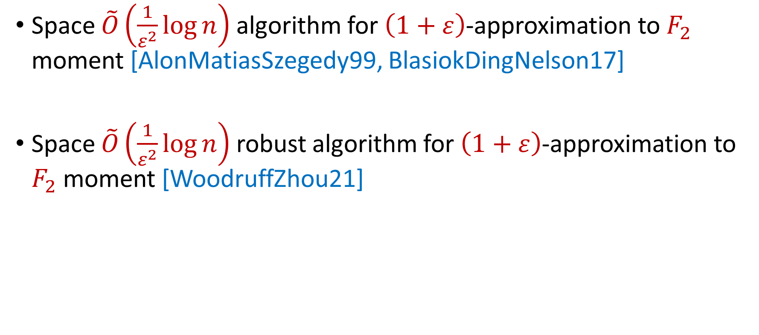
Insertion-Only Streams
Space $\tilde{O}\left(\frac{1}{ε^{2}}\log{n}\right)$ algorithm for $\left(1+ε\right)$-approximation to $F_{2}$ moment [AlonMatiasSzegedy99, BlasiokDingNelson17]
Space $\tilde{O}\left(\frac{1}{ε^{2}}\log{n}\right)$ robust algorithm for $\left(1+ε\right)$-approximation to $F_{2}$ moment [WoodruffZhou21]

Slide 14
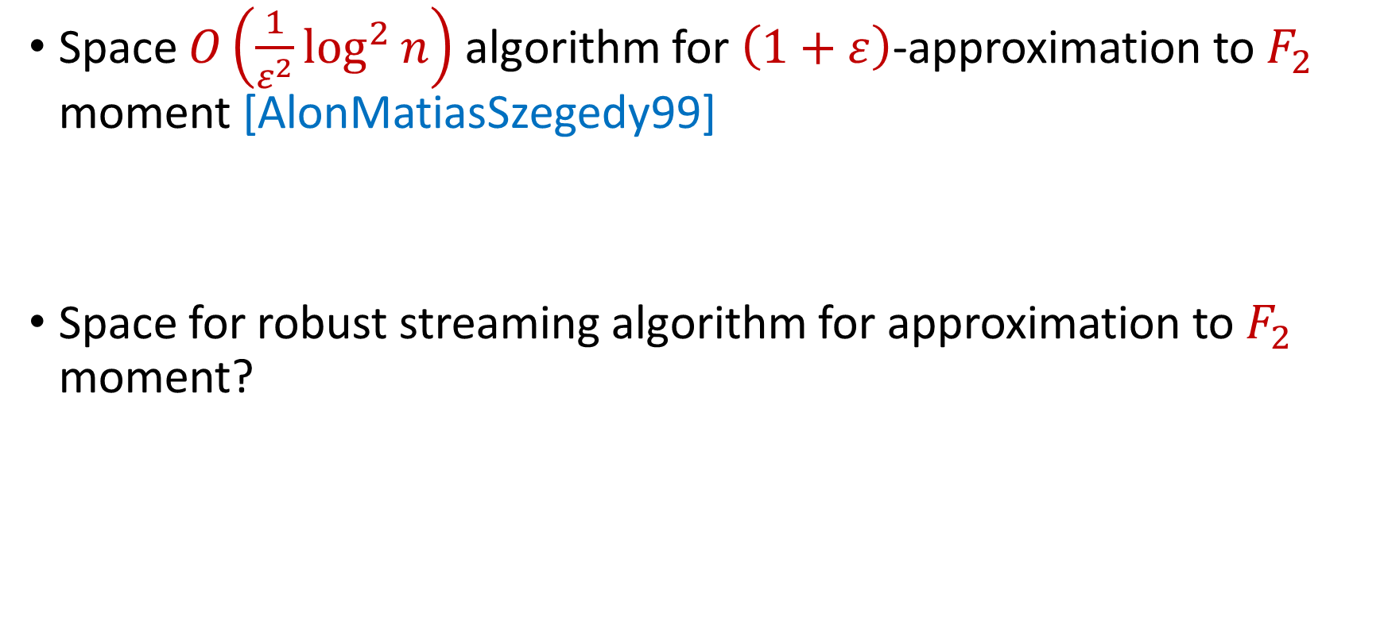
Insertion-Deletion Streams
Space $O\left(\frac{1}{ε^{2}}\log^{2}{n}\right)$ algorithm for $\left(1+ε\right)$-approximation to $F_{2}$ moment [AlonMatiasSzegedy99]
Space for robust streaming algorithm for approximation to $F_{2}$ moment?

Slide 15
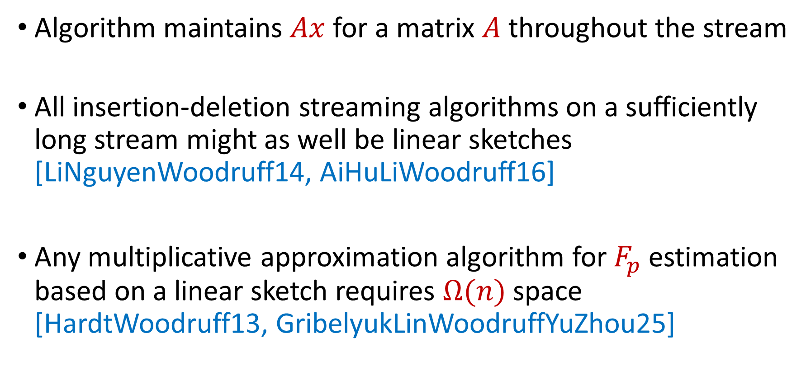
Linear Sketch
Algorithm maintains $Ax$ for a matrix $A$ throughout the stream
All insertion-deletion streaming algorithms on a sufficiently long stream might as well be linear sketches [LiNguyenWoodruff14, AiHuLiWoodruff16]
Any multiplicative approximation algorithm for $F_{p}$ estimation based on a linear sketch requires $Ω(n)$ space [HardtWoodruff13, GribelyukLinWoodruffYuZhou25]

Slide 16
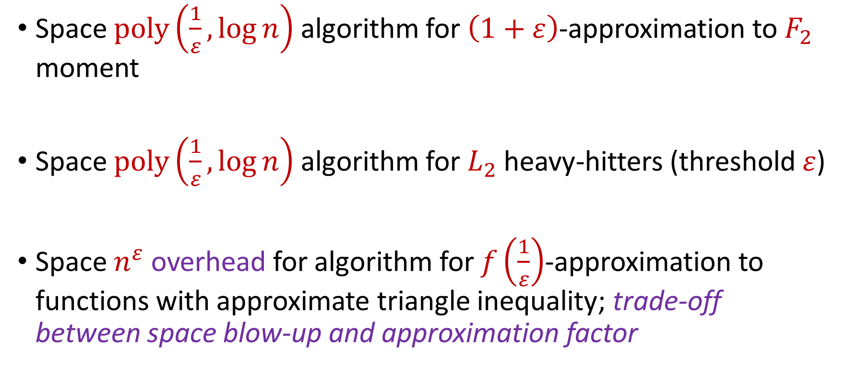
Our Results, Adversarial Robustness on Insertion-Deletion Streams
Space $poly\left(\frac{1}{ε},\log{n}\right)$ algorithm for $\left(1+ε\right)$-approximation to $F_{2}$ moment
Space $poly\left(\frac{1}{ε},\log{n}\right)$ algorithm for $L_{2}$ heavy-hitters (threshold $ε$)
Space $n^{ε}$ overhead for algorithm for $f\left(\frac{1}{ε}\right)$-approximation to functions with approximate triangle inequality; trade-off between space blow-up and approximation factor

Slide 17
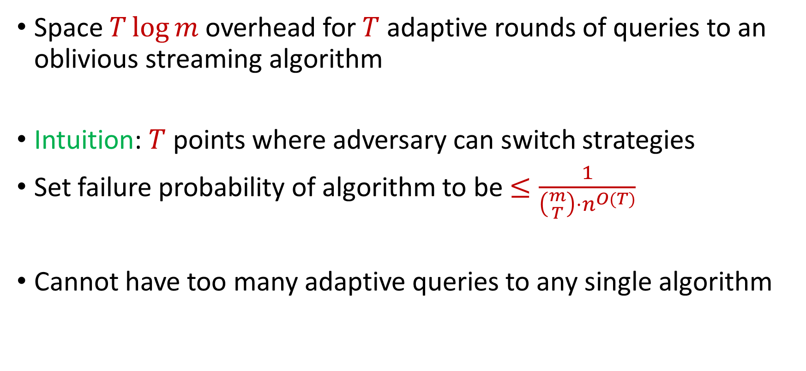
Bounded Computation Paths
Space $T\log{m}$ overhead for $T$ adaptive rounds of queries to an oblivious streaming algorithm
Intuition: $T$ points where adversary can switch strategies
Set failure probability of algorithm to be $≤\frac{1}{\left({m \atop T}\right)⋅n^{O(T)}}$
Cannot have too many adaptive queries to any single algorithm

Slide 18
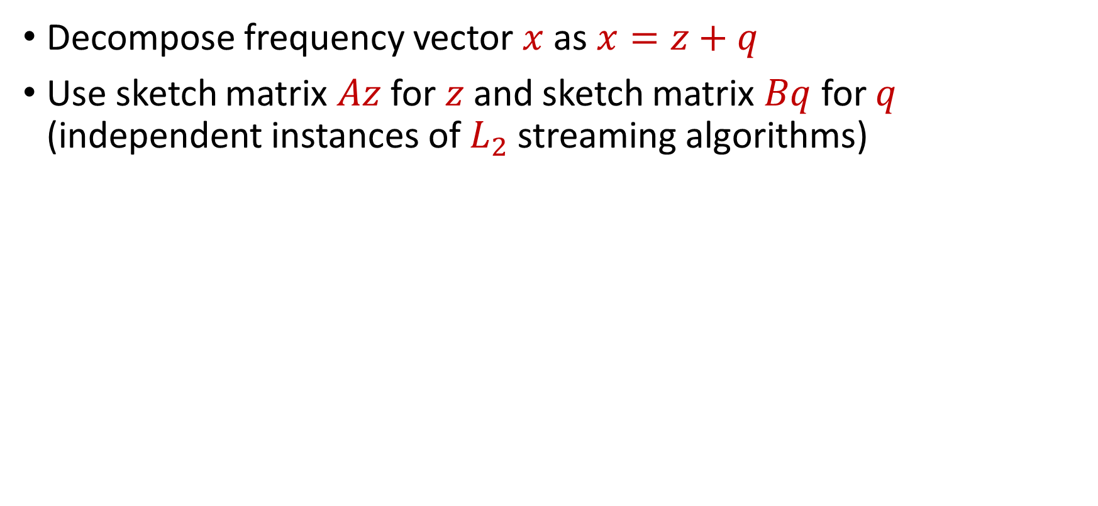



Intuition
Decompose frequency vector $x$ as $x=z+q$
Use sketch matrix $Az$ for $z$ and sketch matrix $Bq$ for $q$ (independent instances of $L_{2}$ streaming algorithms)
$$z$$
$$q$$
Stream
$$x$$

Slide 19
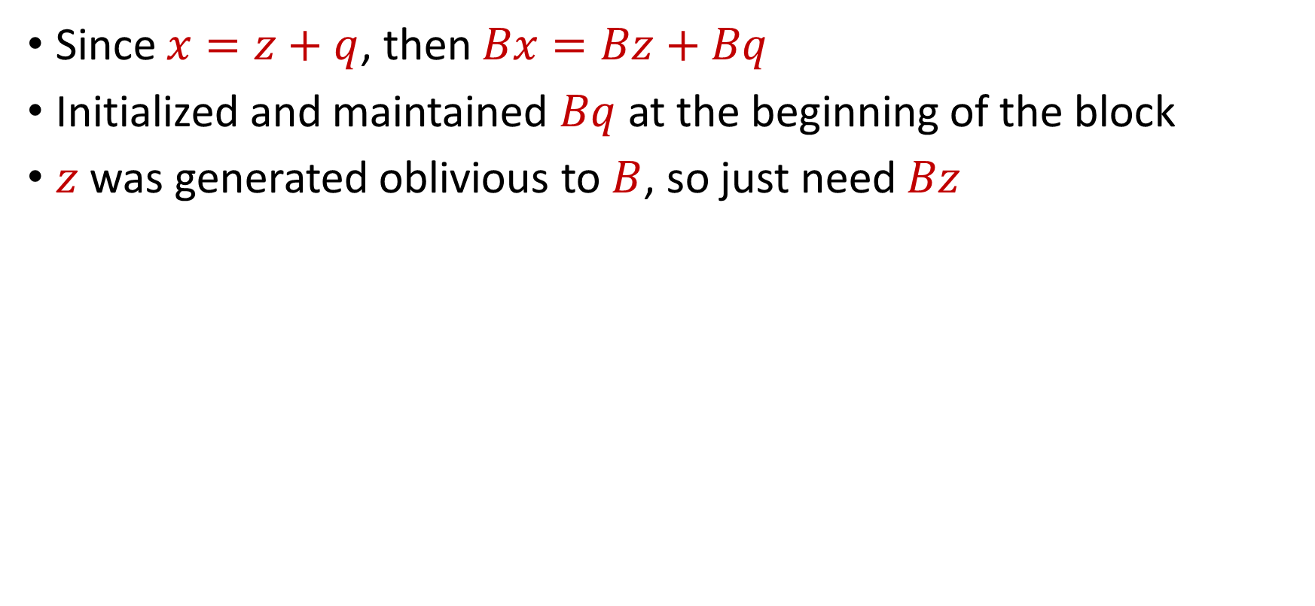
Intuition
Since $x=z+q$, then $Bx=Bz+Bq$
Initialized and maintained $Bq$ at the beginning of the block
$z$ was generated oblivious to $B$, so just need $Bz$
$$z$$
$$q$$
Stream
$$x$$

Slide 20
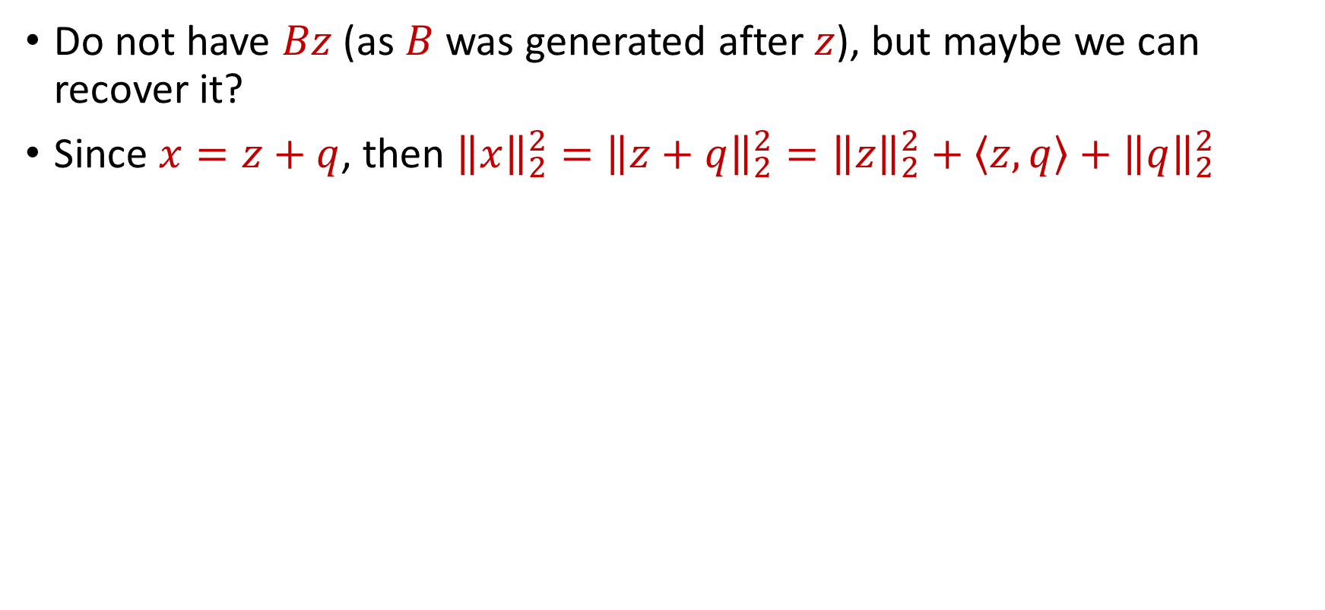
Intuition
Do not have $Bz$ (as $B$ was generated after $z$), but maybe we can recover it?
Since $x=z+q$, then ${\left\|x\right\|}_{2}^{2}={\left\|z+q\right\|}_{2}^{2}={\left\|z\right\|}_{2}^{2}+\left\langle z,q\right\rangle +{\left\|q\right\|}_{2}^{2}$
$$z$$
$$q$$
Stream
$$x$$

Slide 21
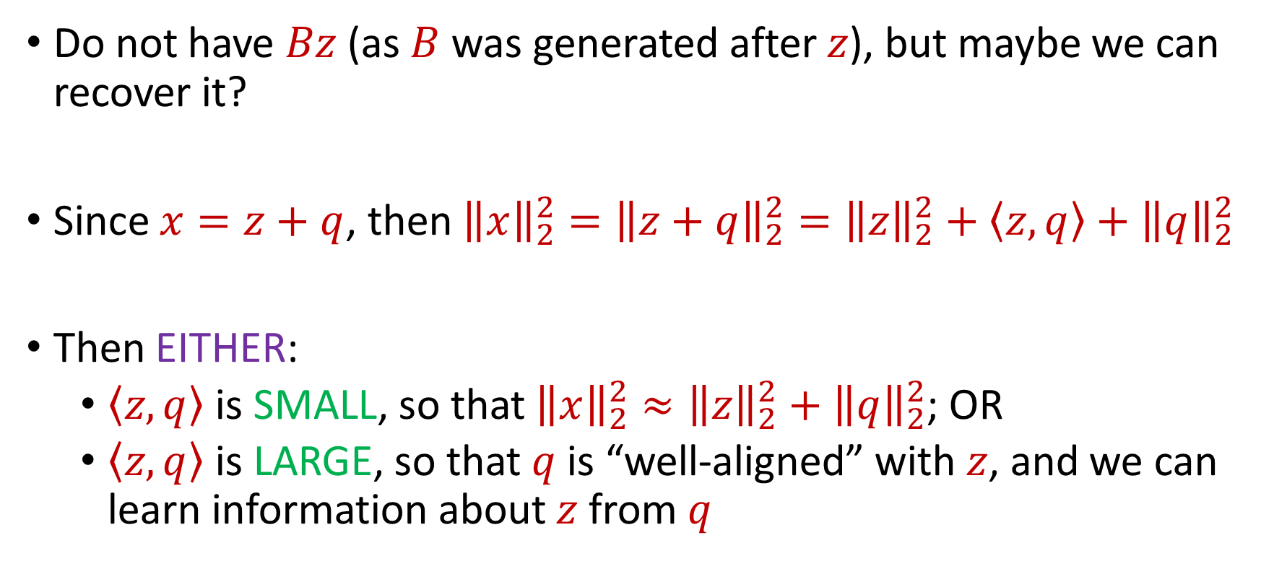
Intuition
Do not have $Bz$ (as $B$ was generated after $z$), but maybe we can recover it?
Since $x=z+q$, then ${\left\|x\right\|}_{2}^{2}={\left\|z+q\right\|}_{2}^{2}={\left\|z\right\|}_{2}^{2}+\left\langle z,q\right\rangle +{\left\|q\right\|}_{2}^{2}$
Then EITHER:
$\left\langle z,q\right\rangle$ is SMALL, so that ${\left\|x\right\|}_{2}^{2}≈{\left\|z\right\|}_{2}^{2}+{\left\|q\right\|}_{2}^{2}$; OR
$\left\langle z,q\right\rangle$ is LARGE, so that $q$ is “well-aligned” with $z$, and we can learn information about $z$ from $q$

Slide 22
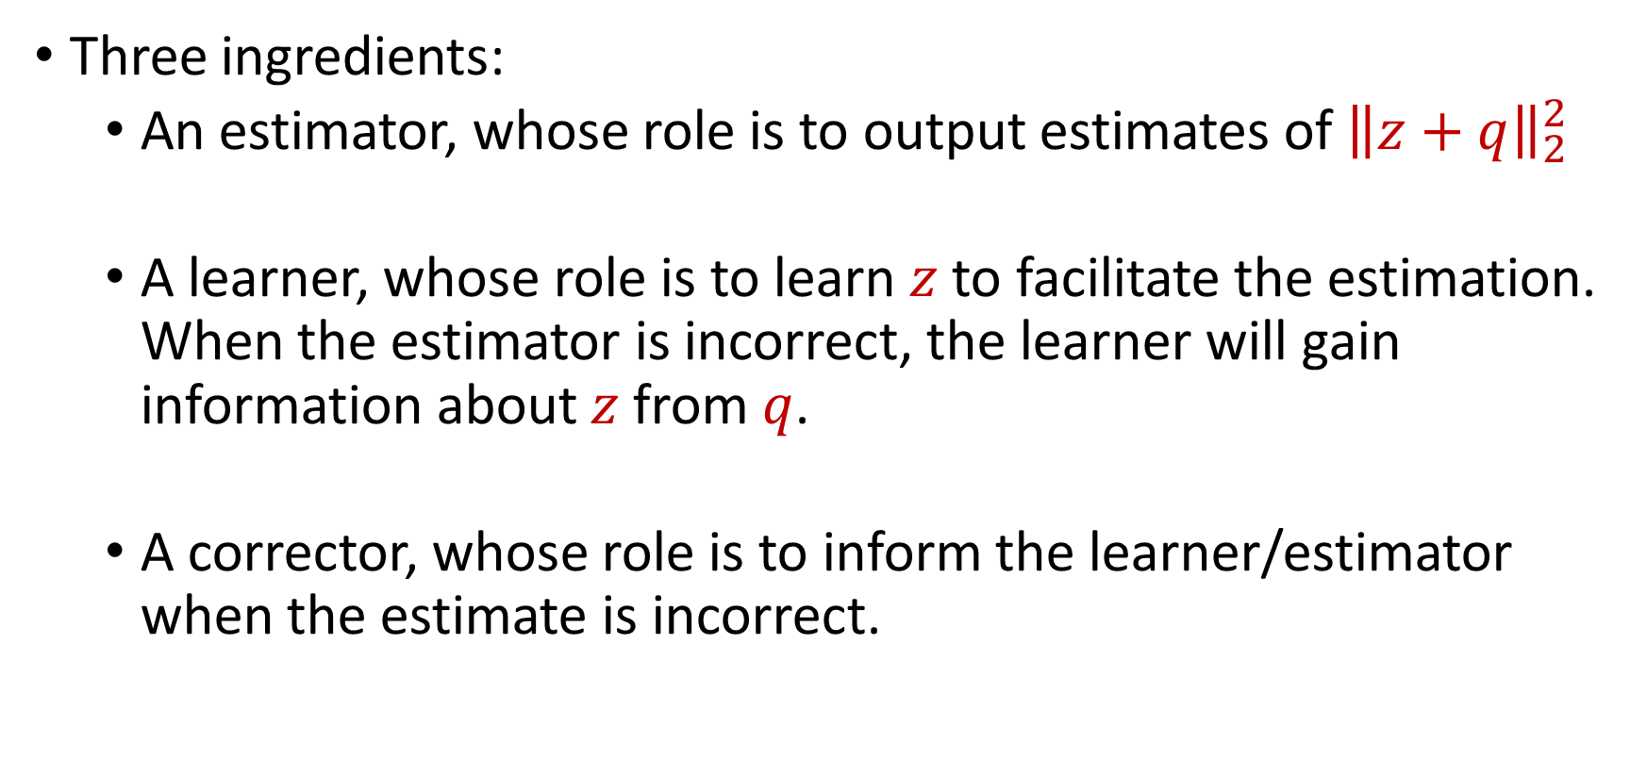
Estimator, Corrector, Learner
Three ingredients:
An estimator, whose role is to output estimates of ${\left\|z+q\right\|}_{2}^{2}$
A learner, whose role is to learn $z$ to facilitate the estimation. When the estimator is incorrect, the learner will gain information about $z$ from $q$.
A corrector, whose role is to inform the learner/estimator when the estimate is incorrect.

Slide 23
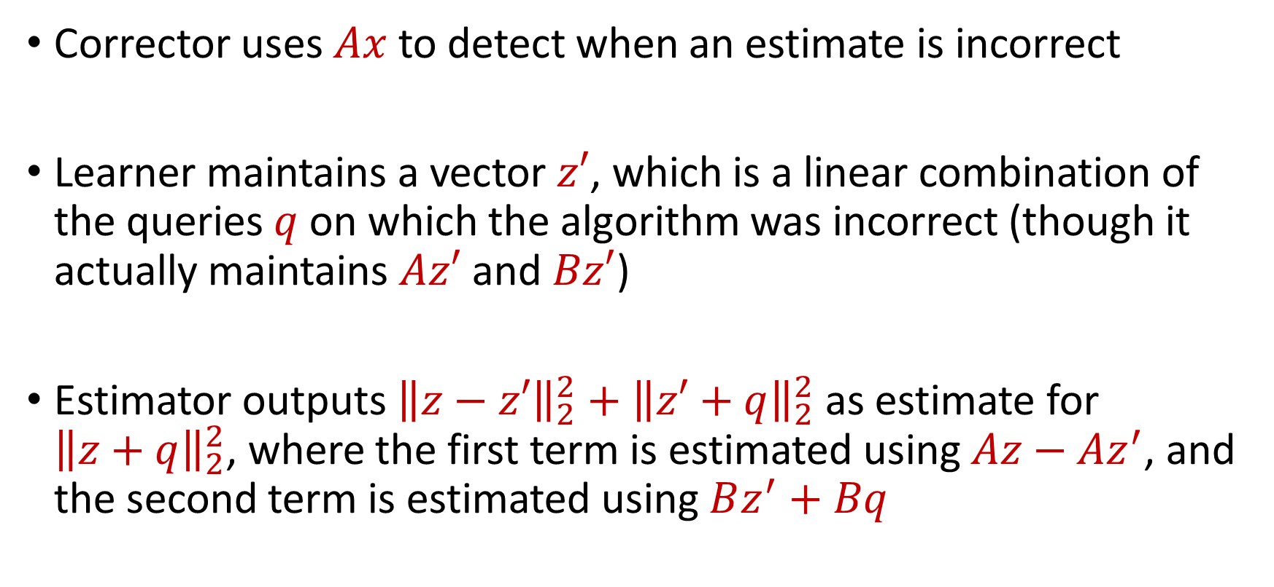
Estimator, Corrector, Learner
Corrector uses $Ax$ to detect when an estimate is incorrect
Learner maintains a vector $z′$, which is a linear combination of the queries $q$ on which the algorithm was incorrect (though it actually maintains $Az′$ and $Bz′$)
Estimator outputs ${\left\|z−z′\right\|}_{2}^{2}+{\left\|z′+q\right\|}_{2}^{2}$ as estimate for ${\left\|z+q\right\|}_{2}^{2}$, where the first term is estimated using $Az−Az^{′}$, and the second term is estimated using $Bz^{′}+Bq$

Slide 24
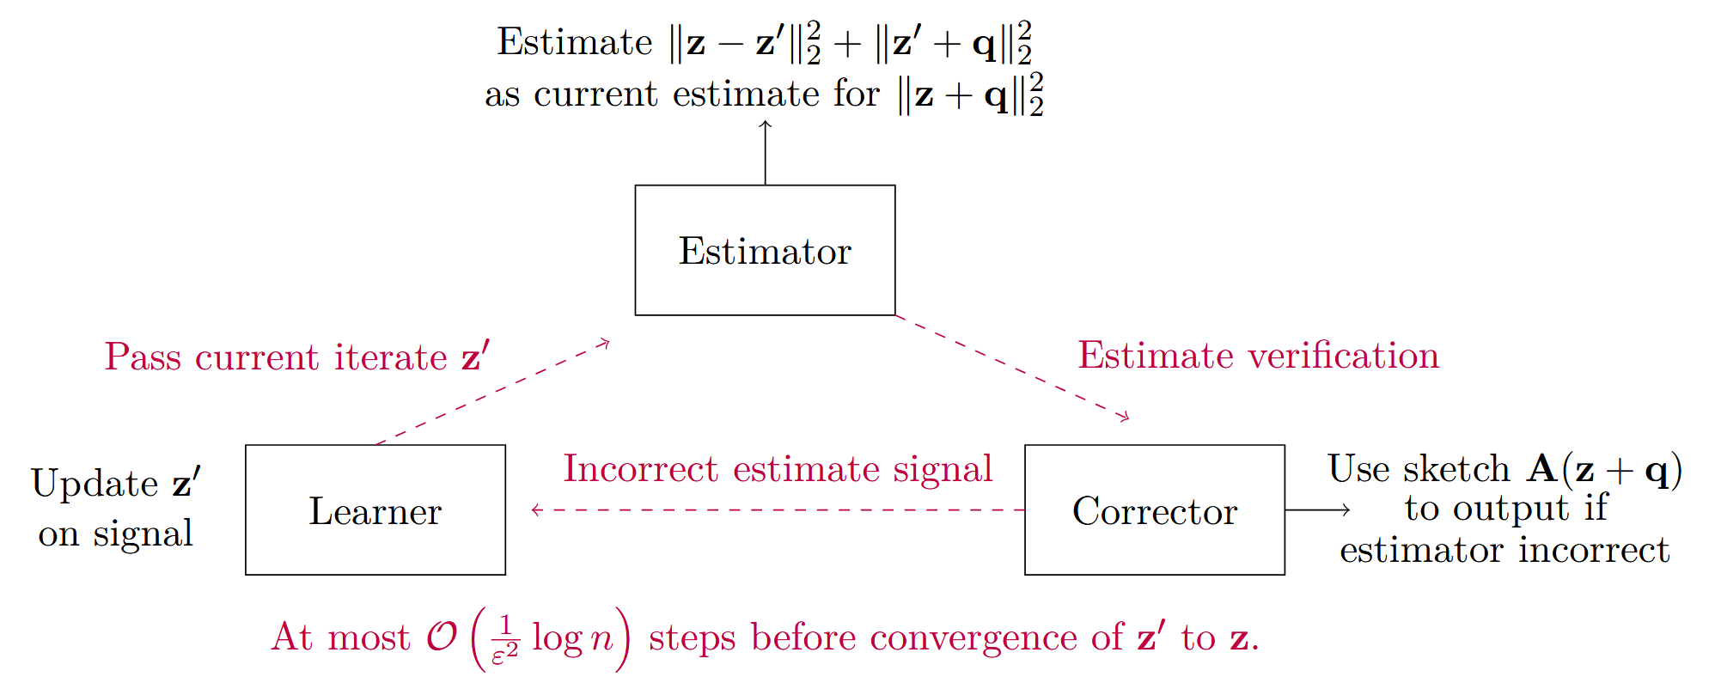
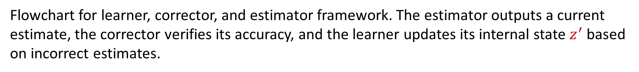
Flowchart for learner, corrector, and estimator framework. The estimator outputs a current estimate, the corrector verifies its accuracy, and the learner updates its internal state $z^{′}$ based on incorrect estimates.

Slide 25
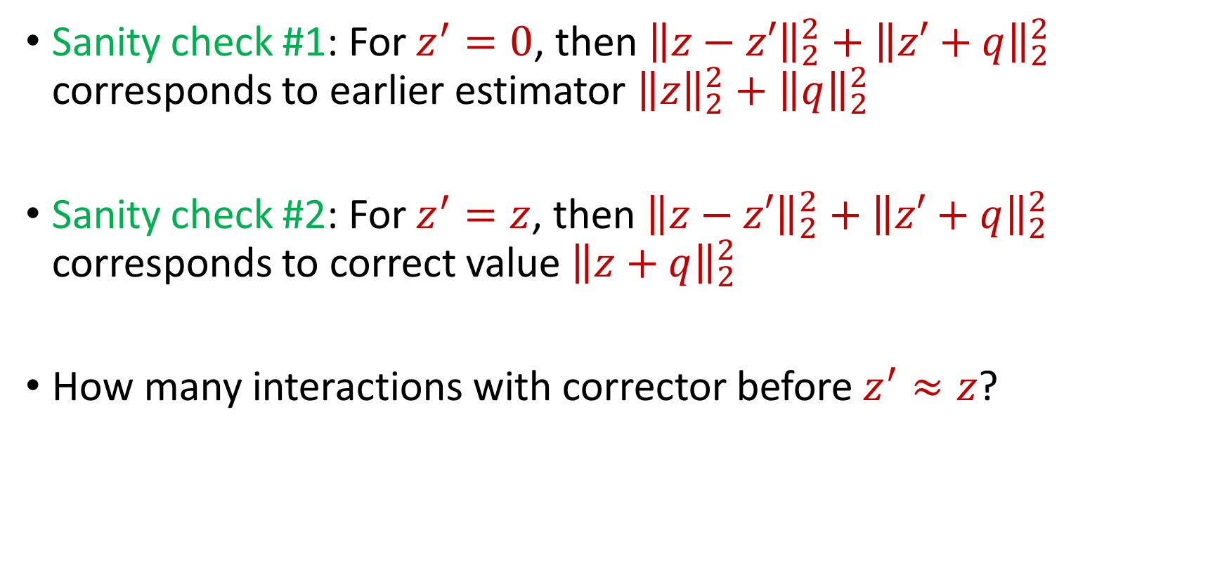
Estimator, Corrector, Learner
Sanity check #1: For $z^{′}=0$, then ${\left\|z−z′\right\|}_{2}^{2}+{\left\|z′+q\right\|}_{2}^{2}$ corresponds to earlier estimator ${\left\|z\right\|}_{2}^{2}+{\left\|q\right\|}_{2}^{2}$
Sanity check #2: For $z^{′}=z$, then ${\left\|z−z′\right\|}_{2}^{2}+{\left\|z′+q\right\|}_{2}^{2}$ corresponds to correct value ${\left\|z+q\right\|}_{2}^{2}$
How many interactions with corrector before $z^{′}≈z$?

Slide 26
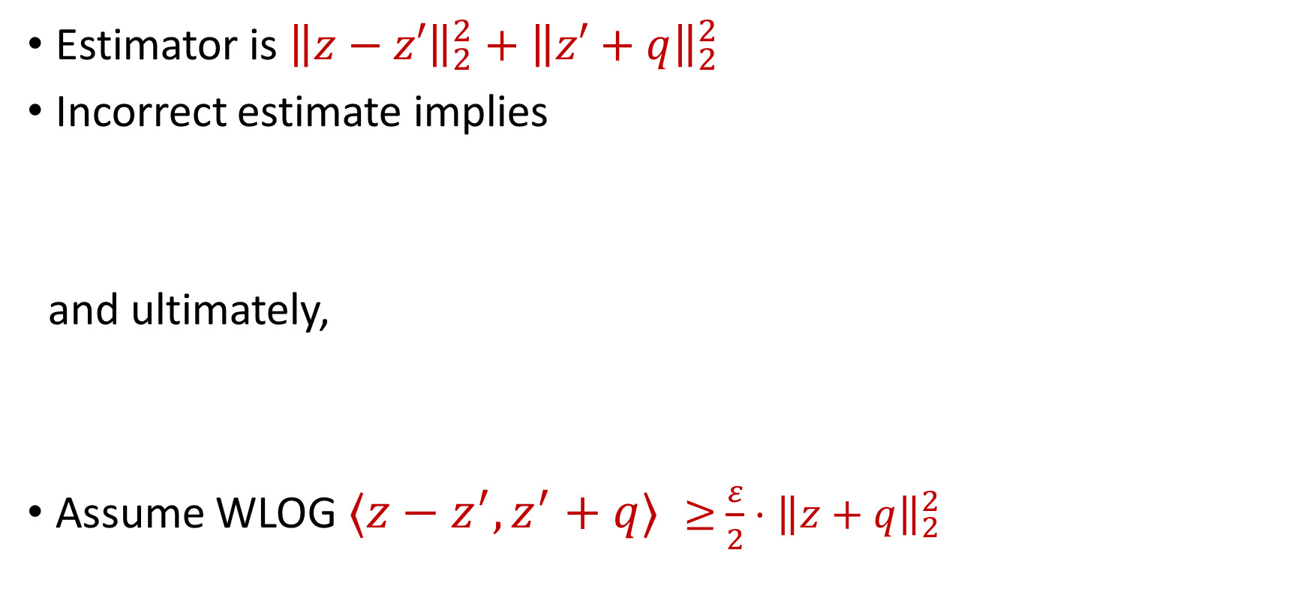
Update Rule
Estimator is ${\left\|z−z′\right\|}_{2}^{2}+{\left\|z′+q\right\|}_{2}^{2}$
Incorrect estimate implies
and ultimately,
Assume WLOG $⟨z−z^{′},z^{′}+q⟩ ≥$ $\frac{ε}{2}⋅{\left\|z+q\right\|}_{2}^{2}$
$\left|{\left\|z−z′\right\|}_{2}^{2}+{\left\|z′+q\right\|}_{2}^{2}−{\left\|z+q\right\|}_{2}^{2}\right|≥$ $ε⋅{\left\|z+q\right\|}_{2}^{2}$
$\left|⟨z−z^{′},z^{′}+q⟩\right|≥$ $\frac{ε}{2}⋅{\left\|z+q\right\|}_{2}^{2}$

Slide 27
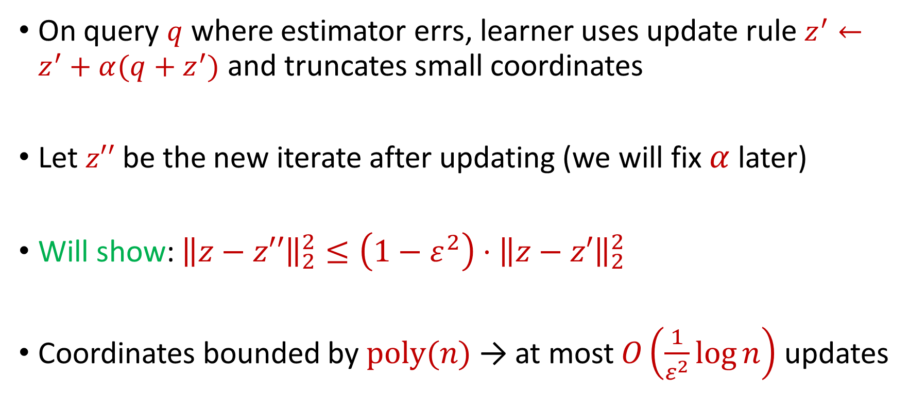
Update Rule
On query $q$ where estimator errs, learner uses update rule $z^{′}←z^{′}+α(q+z^{′})$ and truncates small coordinates
Let $z′′$ be the new iterate after updating (we will fix $α$ later)
Will show: ${\left\|z−z′′\right\|}_{2}^{2}≤\left(1−ε^{2}\right)⋅{\left\|z−z′\right\|}_{2}^{2}$
Coordinates bounded by $poly(n)$ → at most $O\left(\frac{1}{ε^{2}}\log{n}\right)$ updates

Slide 28
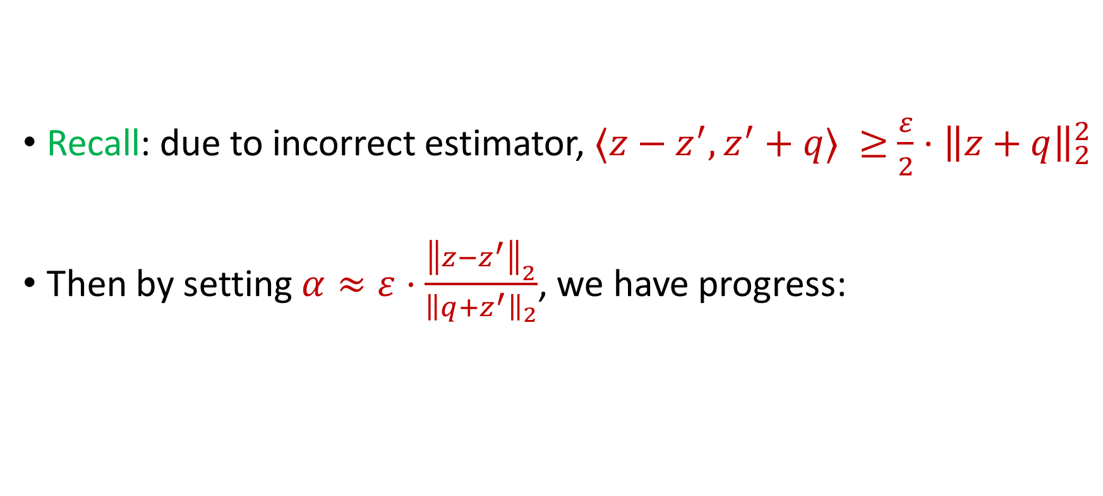

Progress
$${\left\|z−z′′\right\|}_{2}^{2}={\left\|z−z^{′}−α(q+z^{′})\right\|}_{2}^{2}$$
Recall: due to incorrect estimator, $⟨z−z^{′},z^{′}+q⟩ ≥$ $\frac{ε}{2}⋅{\left\|z+q\right\|}_{2}^{2}$
Then by setting $α≈ε⋅\frac{{\left\|z−z^{′}\right\|}_{2}}{{\left\|q+z^{′}\right\|}_{2}}$, we have progress:
$$={\left\|z−z^{′}\right\|}_{2}^{2}+α^{2}⋅{\left\|q+z^{′}\right\|}_{2}^{2}−2α⋅⟨z−z^{′},q+z^{′}〉$$
$${\left\|z−z′′\right\|}_{2}^{2}≤\left(1−ε^{2}\right)⋅{\left\|z−z′\right\|}_{2}^{2}$$

Slide 29
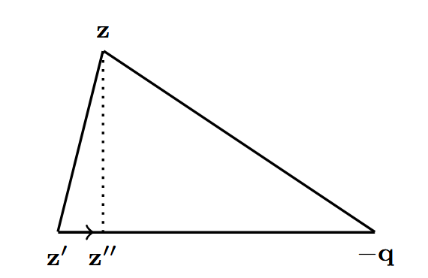
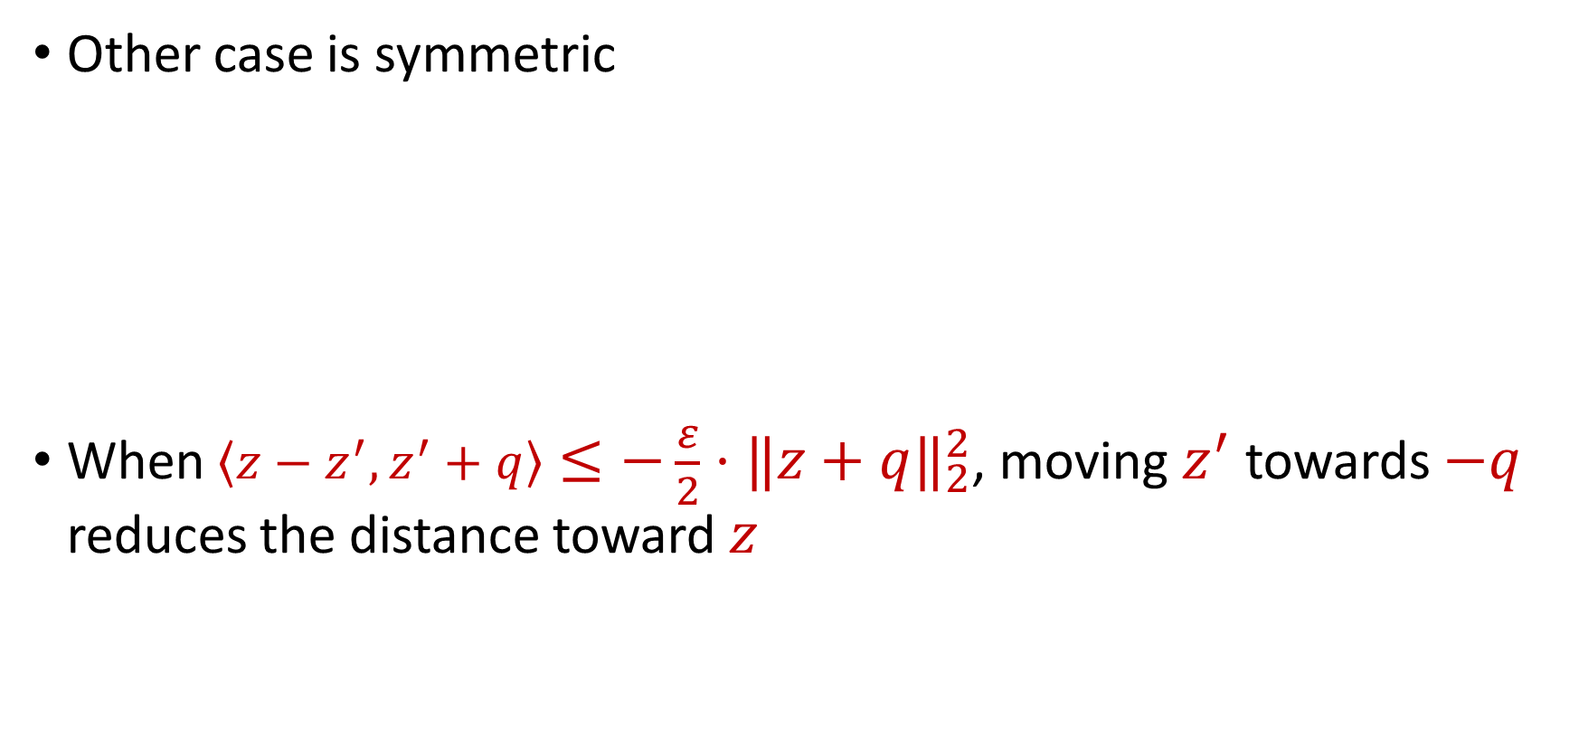
Progress
Other case is symmetric
When $\left\langle z−z^{′},z^{′}+q\right\rangle ≤−\frac{ε}{2}⋅{\left\|z+q\right\|}_{2}^{2}$, moving $z^{′}$ towards $−q$ reduces the distance toward $z$

Slide 30
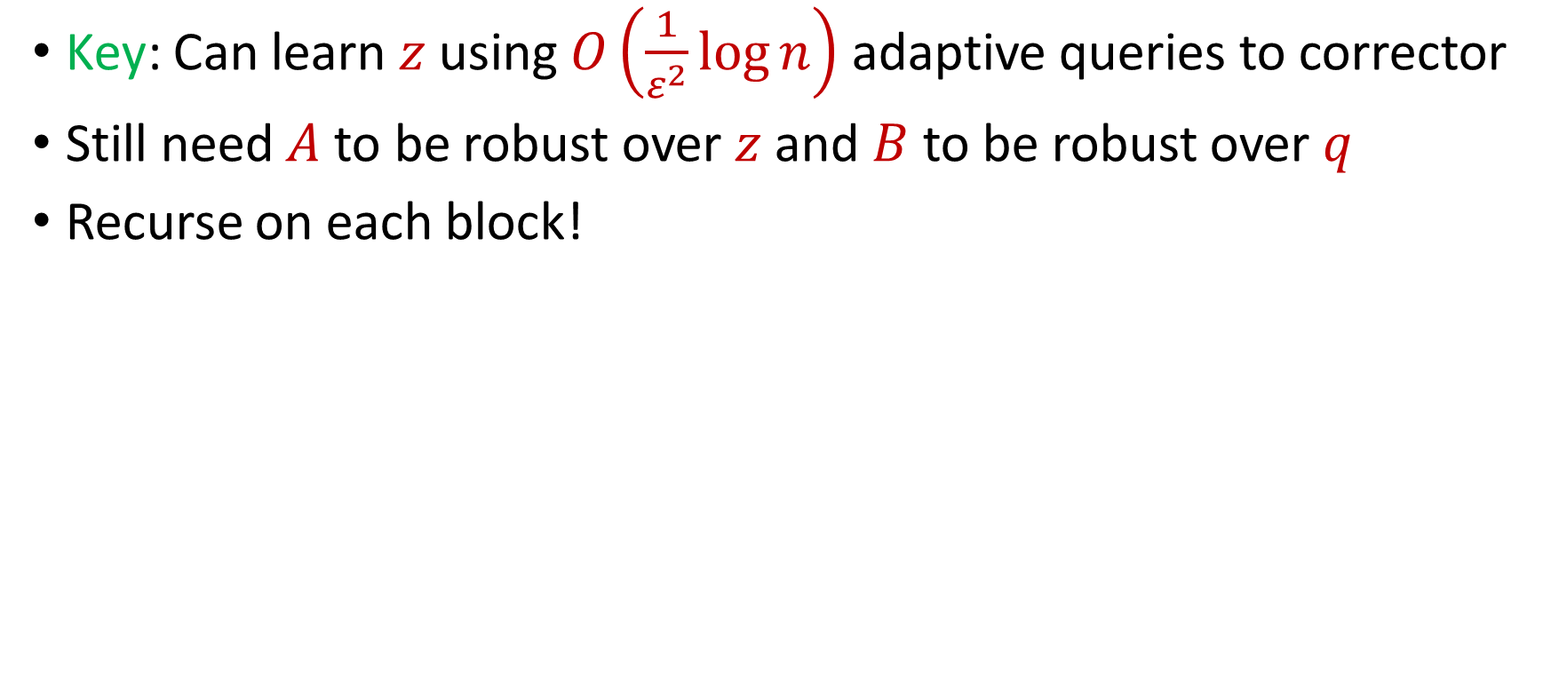



Progress
Key: Can learn $z$ using $O\left(\frac{1}{ε^{2}}\log{n}\right)$ adaptive queries to corrector
Still need $A$ to be robust over $z$ and $B$ to be robust over $q$
Recurse on each block!
$$z$$
$$q$$
Stream
$$x$$

Slide 31
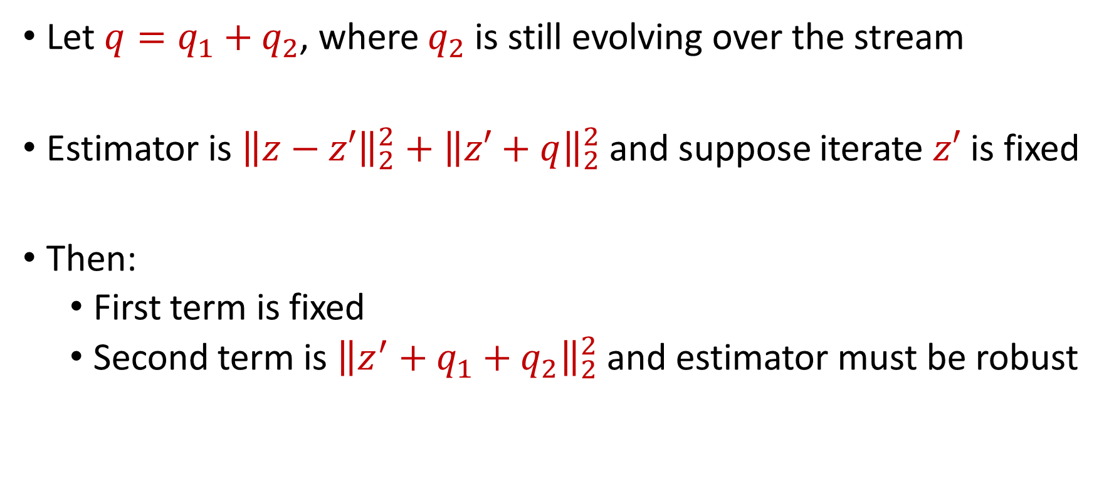
Recursion
Let $q=q_{1}+q_{2}$, where $q_{2}$ is still evolving over the stream
Estimator is ${\left\|z−z′\right\|}_{2}^{2}+{\left\|z′+q\right\|}_{2}^{2}$ and suppose iterate $z′$ is fixed
Then:
First term is fixed
Second term is ${\left\|z^{′}+q_{1}+q_{2}\right\|}_{2}^{2}$ and estimator must be robust

Slide 32
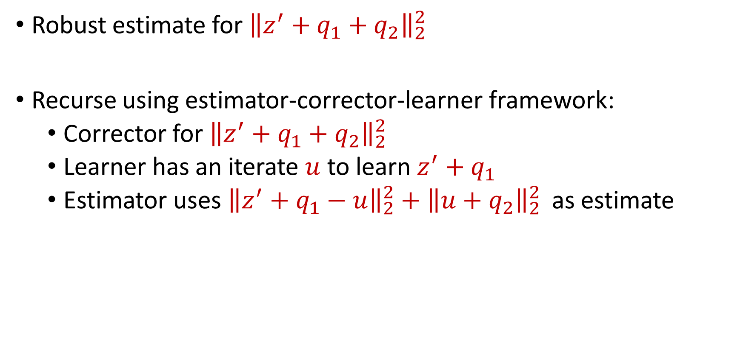
Recursion
Robust estimate for ${\left\|z^{′}+q_{1}+q_{2}\right\|}_{2}^{2}$
Recurse using estimator-corrector-learner framework:
Corrector for ${\left\|z^{′}+q_{1}+q_{2}\right\|}_{2}^{2}$
Learner has an iterate $u$ to learn $z^{′}+q_{1}$
Estimator uses${{\left\|z^{′}+q_{1}−u\right\|}_{2}^{2}+\left\|u+q_{2}\right\|}_{2}^{2}$ as estimate

Slide 33
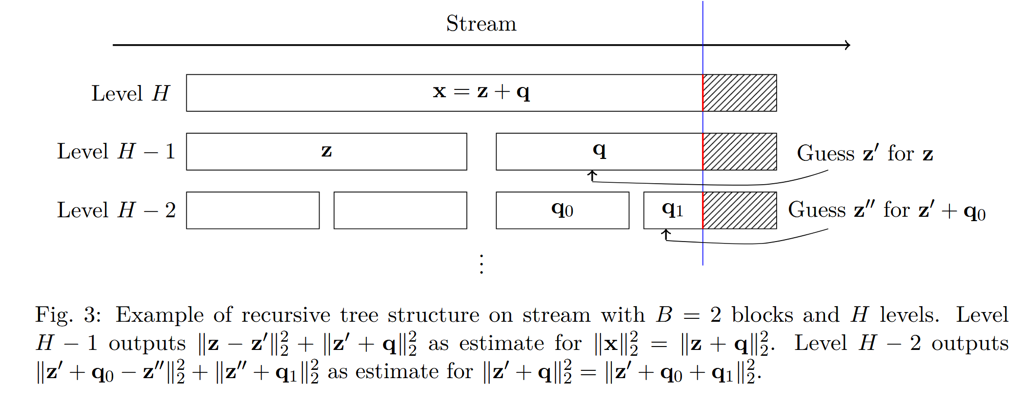

Slide 34
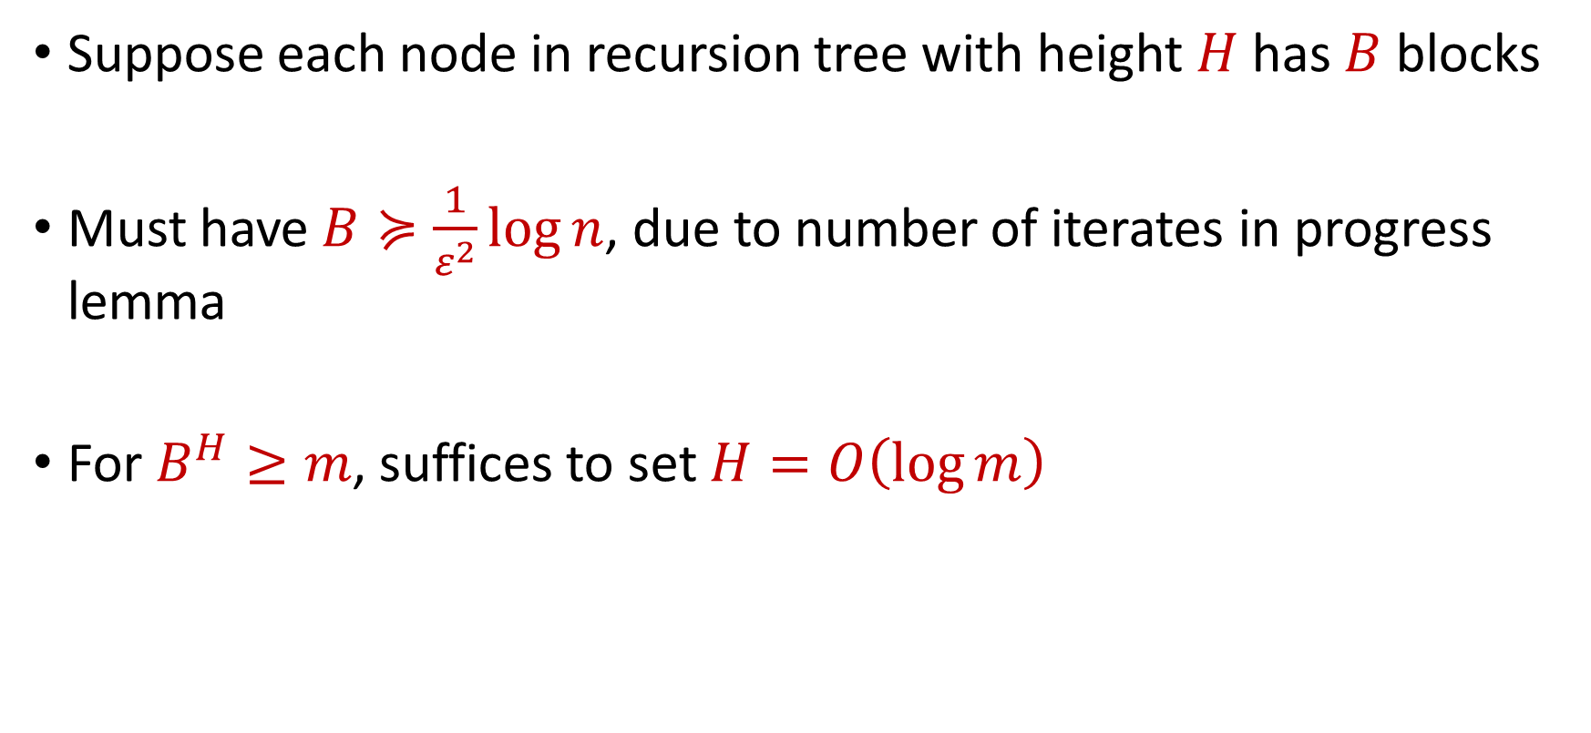
Recursion Tree
Suppose each node in recursion tree with height $H$ has $B$ blocks
Must have $B≽\frac{1}{ε^{2}}\log{n}$, due to number of iterates in progress lemma
For $B^{H}≥m$, suffices to set $H=O\left(\log{m}\right)$

Slide 35
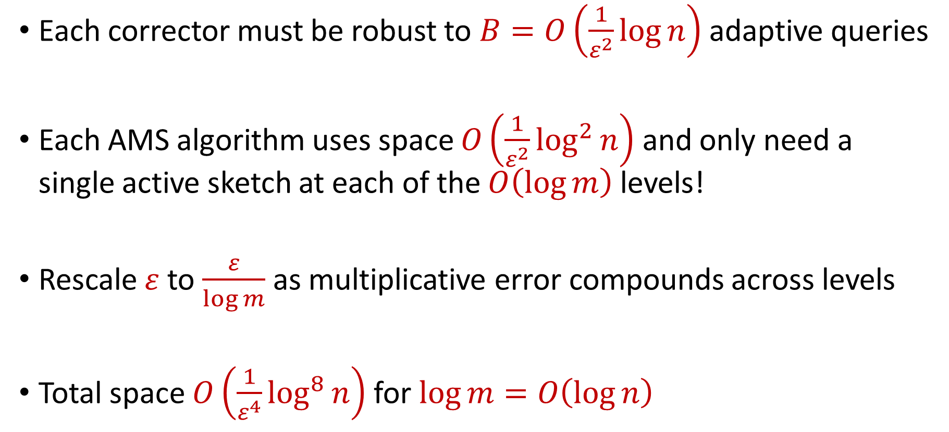
Space Complexity
Each corrector must be robust to $B=O\left(\frac{1}{ε^{2}}\log{n}\right)$ adaptive queries
Each AMS algorithm uses space $O\left(\frac{1}{ε^{2}}\log^{2}{n}\right)$ and only need a single active sketch at each of the $O\left(\log{m}\right)$ levels!
Rescale $ε$ to $\frac{ε}{\log{m}}$ as multiplicative error compounds across levels
Total space $O\left(\frac{1}{ε^{4}}\log^{8}{n}\right)$ for $\log{m}=O\left(\log{n}\right)$

Slide 36
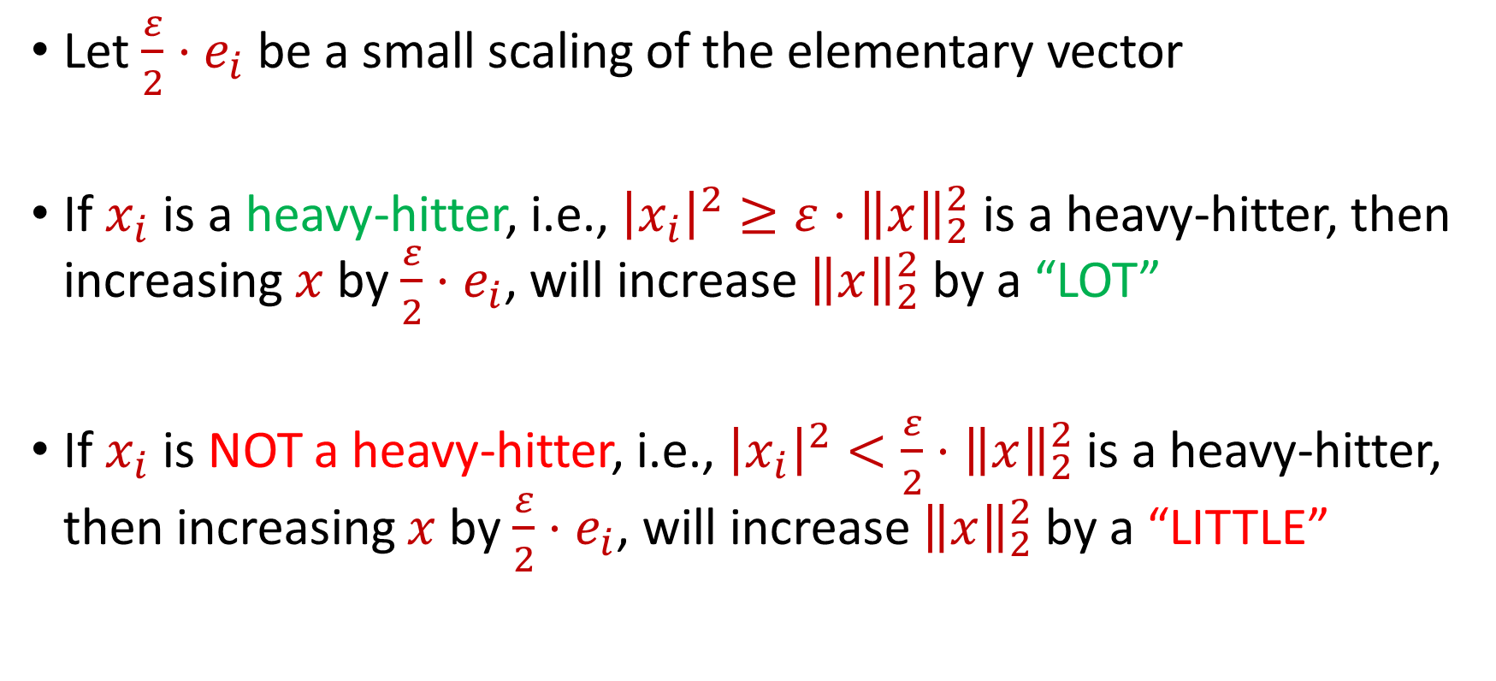
Heavy-Hitters
Let $\frac{ε}{2}⋅e_{i}$ be a small scaling of the elementary vector
If $x_{i}$ is a heavy-hitter, i.e., ${\left|x_{i}\right|}^{2}≥ε⋅{\left\|x\right\|}_{2}^{2}$ is a heavy-hitter, then increasing $x$ by $\frac{ε}{2}⋅e_{i}$, will increase ${\left\|x\right\|}_{2}^{2}$ by a “LOT”
If $x_{i}$ is NOT a heavy-hitter, i.e., ${\left|x_{i}\right|}^{2}<\frac{ε}{2}⋅{\left\|x\right\|}_{2}^{2}$ is a heavy-hitter, then increasing $x$ by $\frac{ε}{2}⋅e_{i}$, will increase ${\left\|x\right\|}_{2}^{2}$ by a “LITTLE”

Slide 37
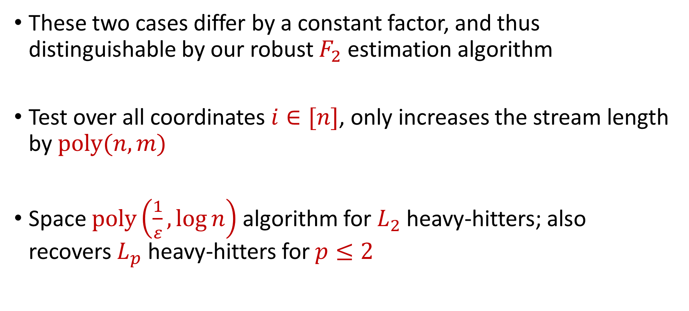
Heavy-Hitters
These two cases differ by a constant factor, and thus distinguishable by our robust $F_{2}$ estimation algorithm
Test over all coordinates $i∈[n]$, only increases the stream length by $poly(n,m)$
Space $poly\left(\frac{1}{ε},\log{n}\right)$ algorithm for $L_{2}$ heavy-hitters; also recovers $L_{p}$ heavy-hitters for $p≤2$

Slide 38
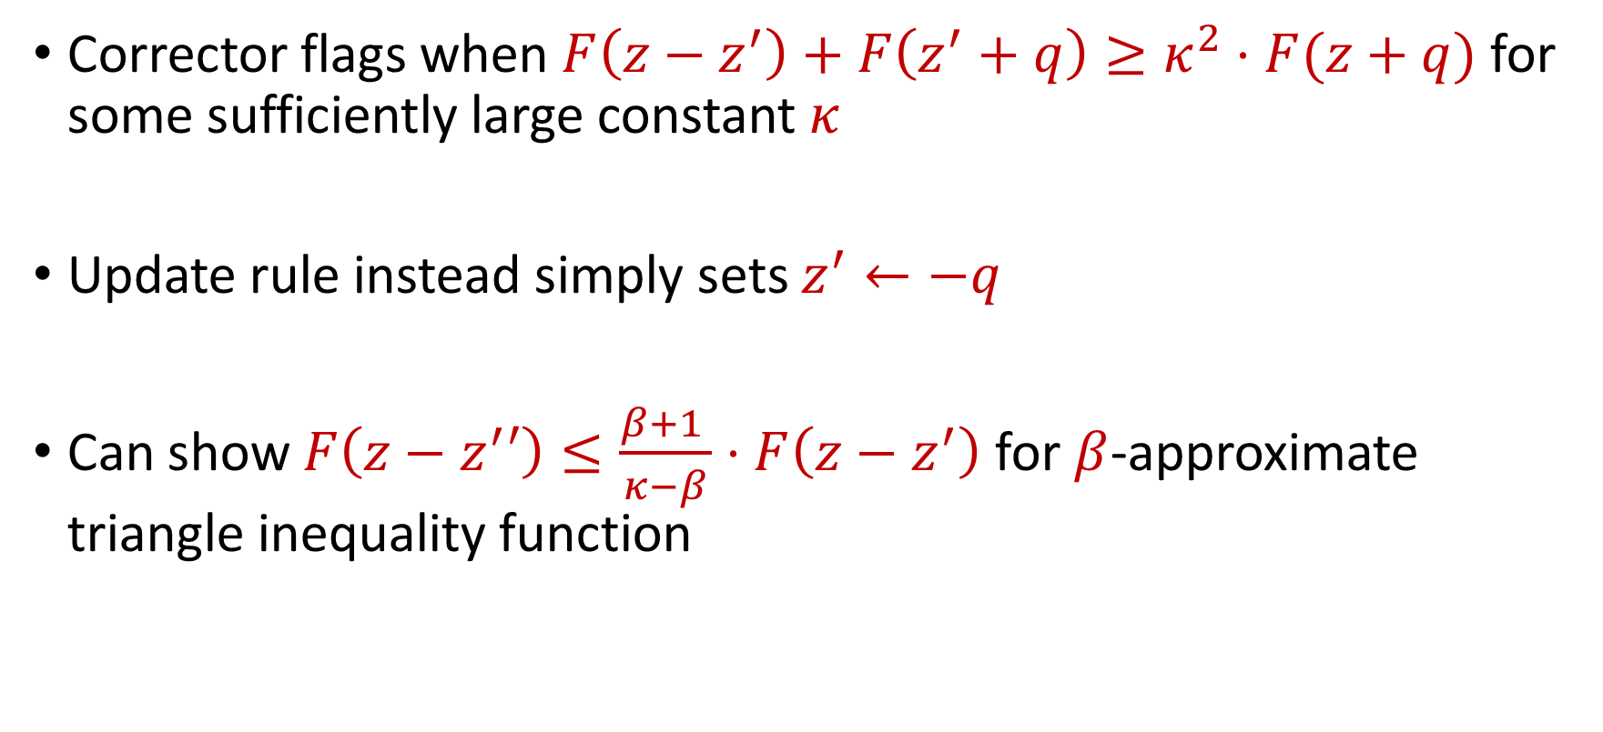
Approximate Triangle Inequality
Corrector flags when $F\left(z−z^{′}\right)+F\left(z^{′}+q\right)≥κ^{2}⋅F(z+q)$ for some sufficiently large constant $κ$
Update rule instead simply sets $z^{′}←−q$
Can show $F\left(z−z^{′}′\right)≤\frac{β+1 }{κ−β}⋅F\left(z−z^{′}\right)$ for $β$-approximate triangle inequality function

Slide 39
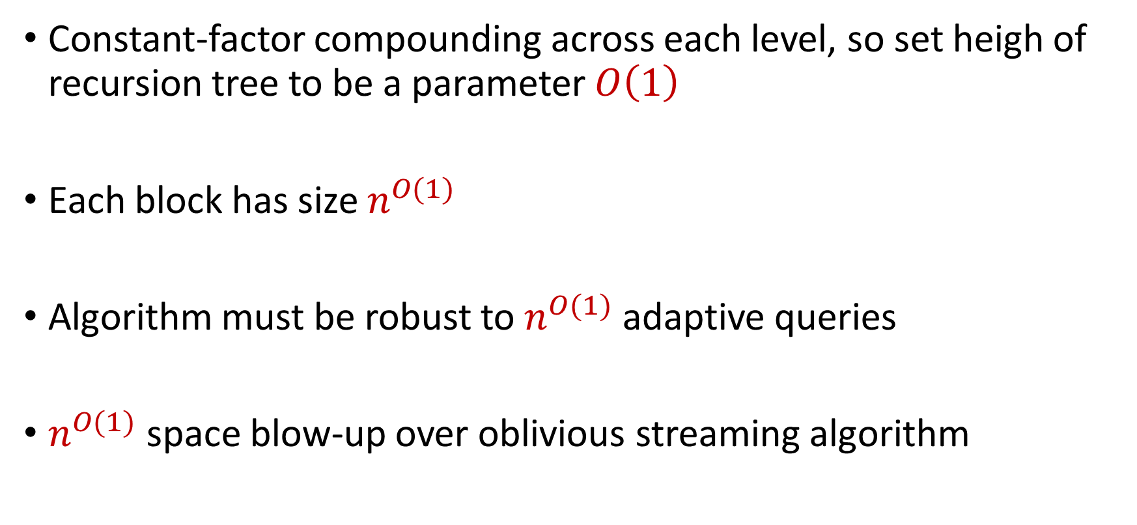
Approximate Triangle Inequality
Constant-factor compounding across each level, so set heigh of recursion tree to be a parameter $O\left(1\right)$
Each block has size $n^{O(1)}$
Algorithm must be robust to $n^{O(1)}$ adaptive queries
$n^{O(1)}$ space blow-up over oblivious streaming algorithm

Slide 40

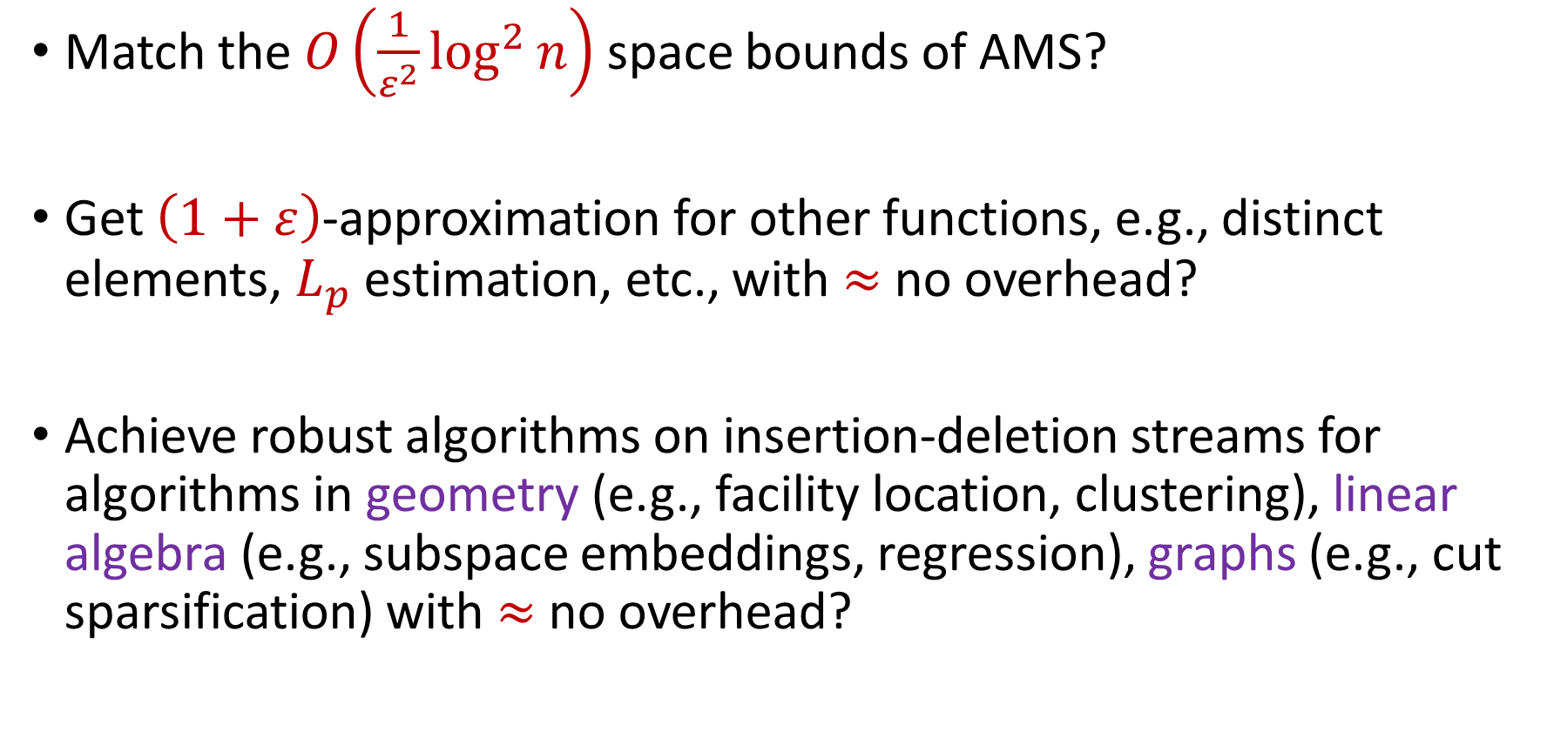
Future Directions?
Match the $O\left(\frac{1}{ε^{2}}\log^{2}{n}\right)$ space bounds of AMS?
Get $\left(1+ε\right)$-approximation for other functions, e.g., distinct elements, $L_{p}$ estimation, etc., with $≈$ no overhead?
Achieve robust algorithms on insertion-deletion streams for algorithms in geometry (e.g., facility location, clustering), linear algebra (e.g., subspace embeddings, regression), graphs (e.g., cut sparsification) with $≈$ no overhead?

Slide 41
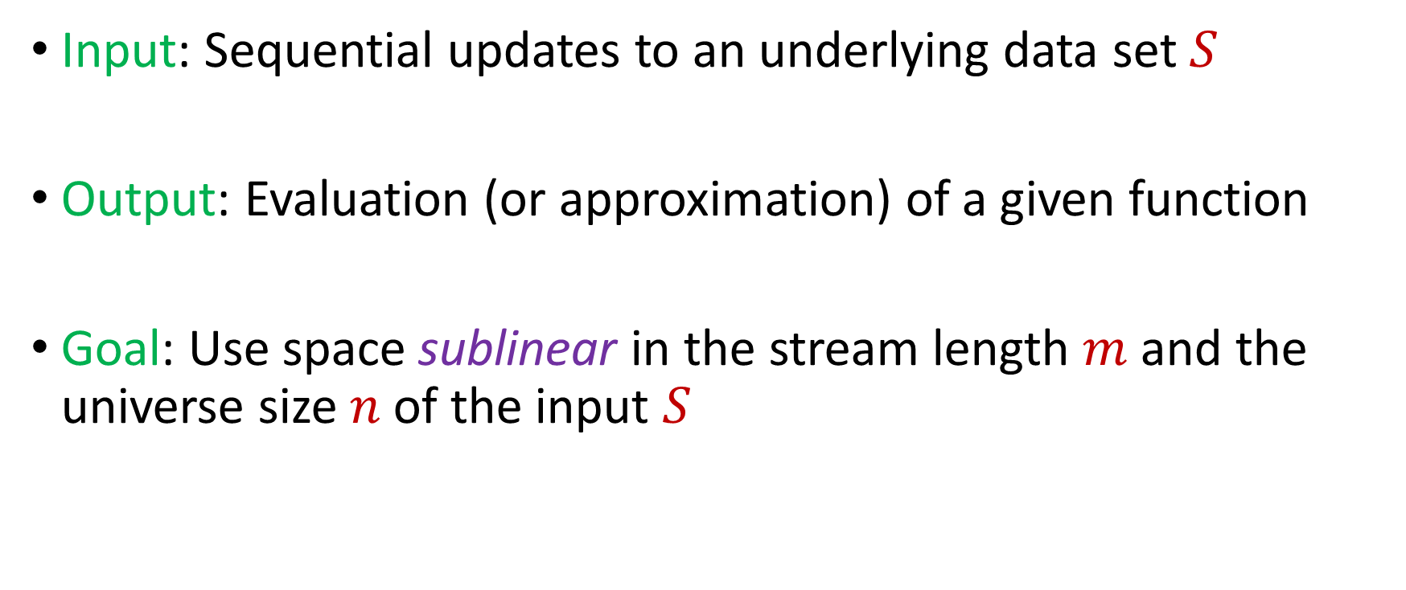
Model #1: Streaming Model
Input: Sequential updates to an underlying data set $S$
Output: Evaluation (or approximation) of a given function
Goal: Use space sublinear in the stream length $m$ and the universe size $n$of the input $S$

Slide 42
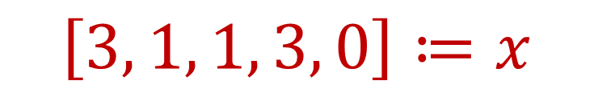
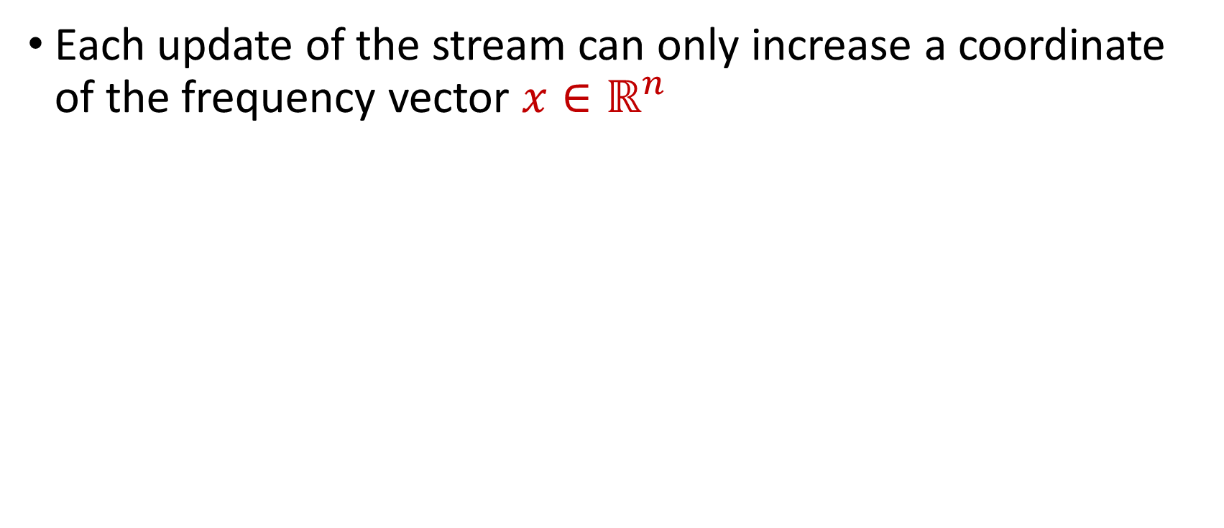
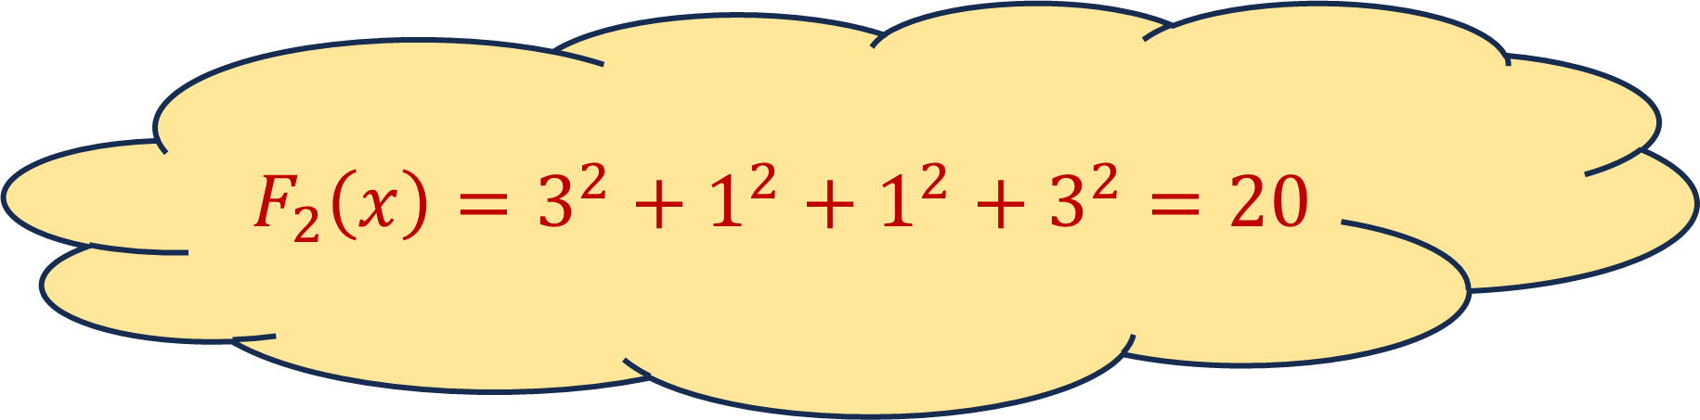
Insertion-Only Streams
Each update of the stream can only increase a coordinate of the frequency vector $x∈ℝ^{n}$
1 4 2 1 3 4 4 1 
$$\left[3, 1, 1, 3, 0\right]≔x$$
$$F_{2}\left(x\right)=3^{2}+1^{2}+1^{2}+3^{2}=20$$

Slide 43
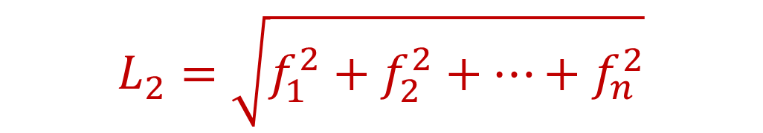
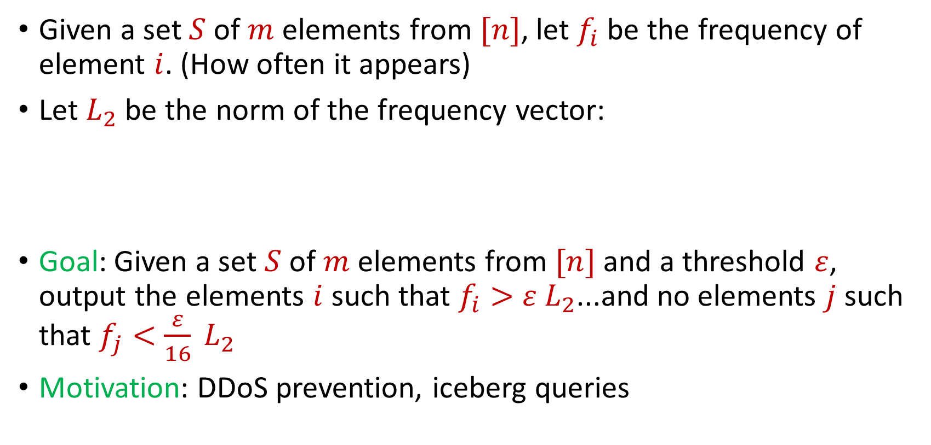
Heavy-Hitters
Given a set $S$ of $m$ elements from $[n]$, let $f_{i}$ be the frequency of element $i$. (How often it appears)
Let $L_{2}$ be the norm of the frequency vector:
Goal: Given a set $S$ of $m$ elements from $[n]$ and a threshold $ε$, output the elements $i$ such that $f_{i}>$ $ε L_{2}$...and no elements $j$ such that $f_{j}<$ $\frac{ε}{16} L_{2}$
Motivation: DDoS prevention, iceberg queries
$$L_{2}=\sqrt{f_{1}^{2}+f_{2}^{2}+…+f_{n}^{2}}$$

Slide 44
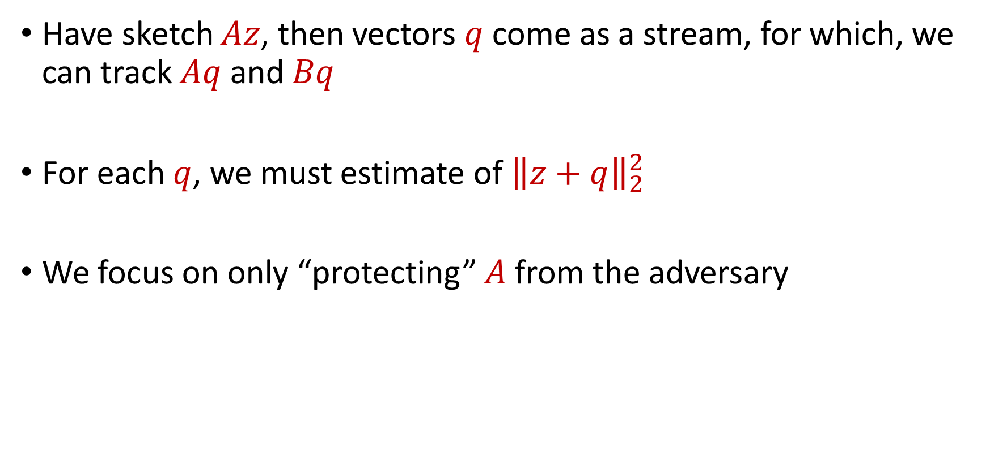
Setup
Have sketch $Az$, then vectors $q$ come as a stream, for which, we can track $Aq$ and $Bq$
For each $q$, we must estimate of ${\left\|z+q\right\|}_{2}^{2}$
We focus on only “protecting” $A$ from the adversary

Slide 45
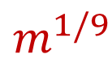
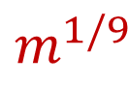
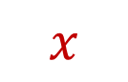











$$m$$
$$x$$
Stream
$$m^{1/3}$$
$$m^{1/3}$$
$$m^{1/3}$$
$$m^{1/9}$$
$$m^{1/9}$$
$$m^{1/9}$$
$$m^{1/9}$$
$$m^{1/9}$$
$$m^{1/9}$$
$$m^{1/9}$$
$$m^{1/9}$$
$$m^{1/9}$$

